Slide 1
Switch Statement in C

Slide 2
Switch Statement
Instead of writing many if..else statements, you can use the switch statement.
The switch statement selects one of many code blocks to be executed:

Slide 3
Syntax
switch(expression) { case x: // code block break; case y: // code block break; default: // code block }

Slide 4
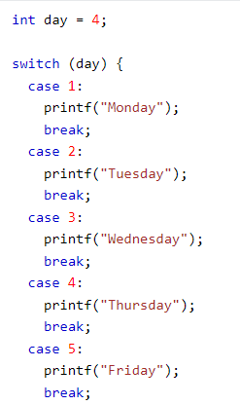

Slide 5
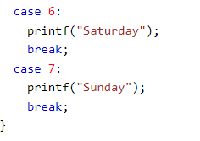


Slide 6
Basic Syntax of Functions
The basic syntax of functions in C programming is:
return_type function_name(arg1, arg2, … argn)
{
Body of the function //Statements to be processed
}

Slide 7
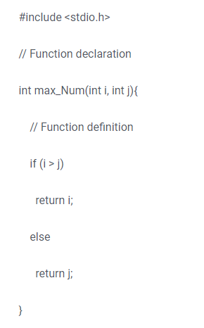

Slide 8
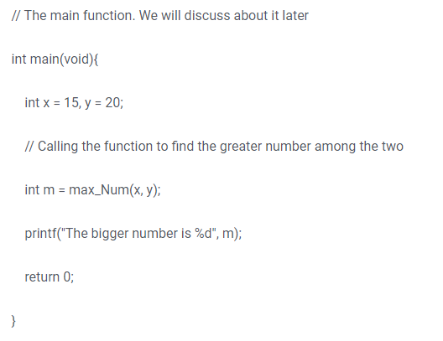

Slide 9
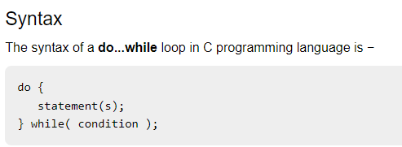

Slide 10
